Slide 1
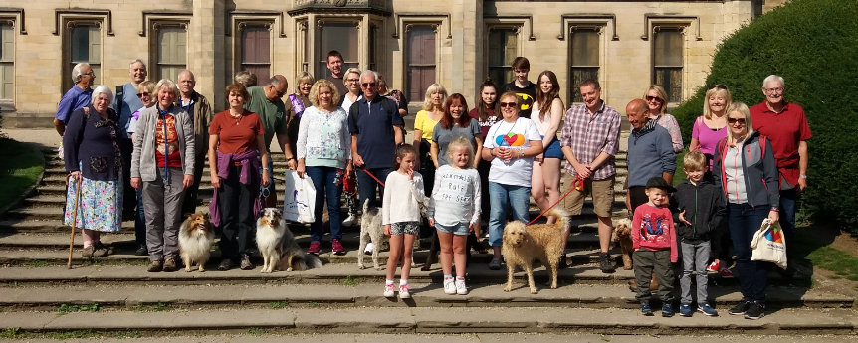
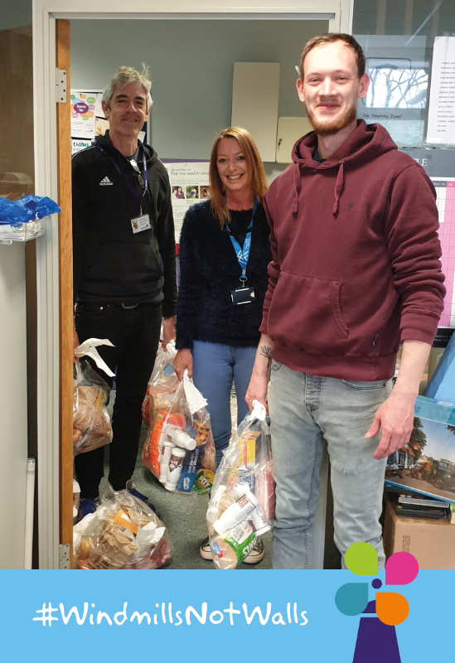
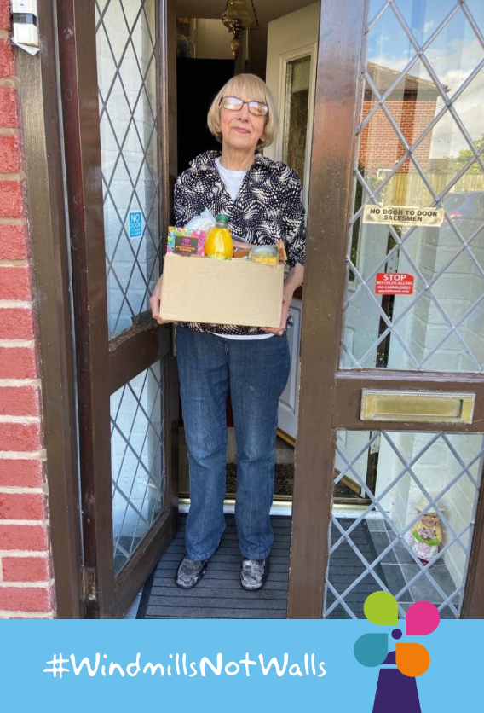
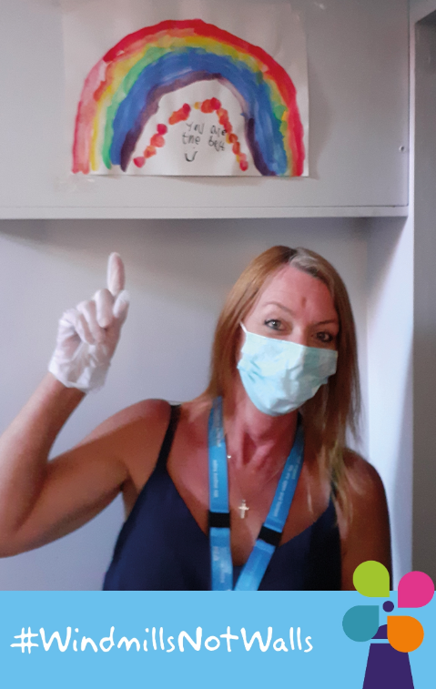
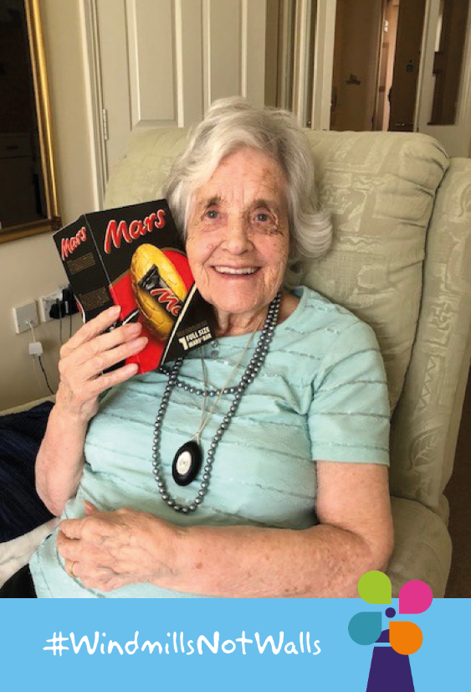
Cheshire East Carers Service

Slide 2
Representing Making Space
Cath Magee, Regional Head of Operations
Lisa Taaffe, Senior Development Manager
Jane Reeves, Service Manager

Slide 3
Todays Presentation
Introduction to Making Space
Cheshire East Carers Service Model
Progress to date (from 01.01.23)
Carer Support Now
The Development Plans

Slide 4
Introduction to Making Space
For over 40 years we have provided care and support and operate from Cumbria to Cambridge.
We support people in their own home, in their local community and with specialist support services. Alongside Carers Services our other services include:
– Residential and nursing homes
– Supported living and extra care
– Floating support
– Independent hospitals
– Community support and social inclusion
– Employment and wellbeing
– Psychological therapies

Slide 5
Introduction to Making Space
Each year we support over 20,000 carers.
We deliver specialisms including dementia and mental health as well as generic carer services, young adult carers and young carer services in partnership with Footsteps 2000.
Vision: We will put wellbeing at the heart of health and social care.
Mission: Together we build relationships, connect communities and provide quality care as unique as the people we support.
Our Values:

Slide 6
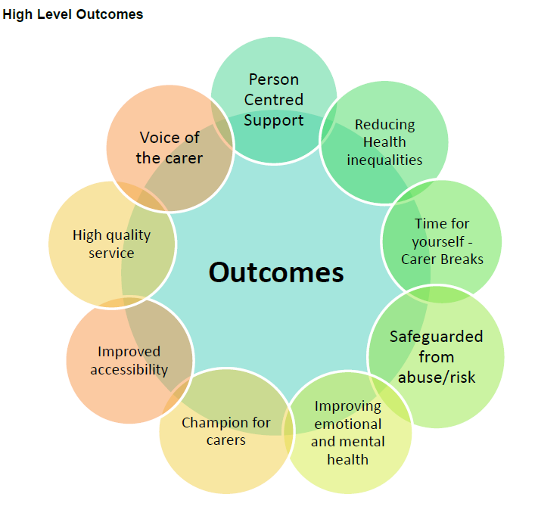
Cheshire East Carers Service Model
Service Model Purpose

Slide 7
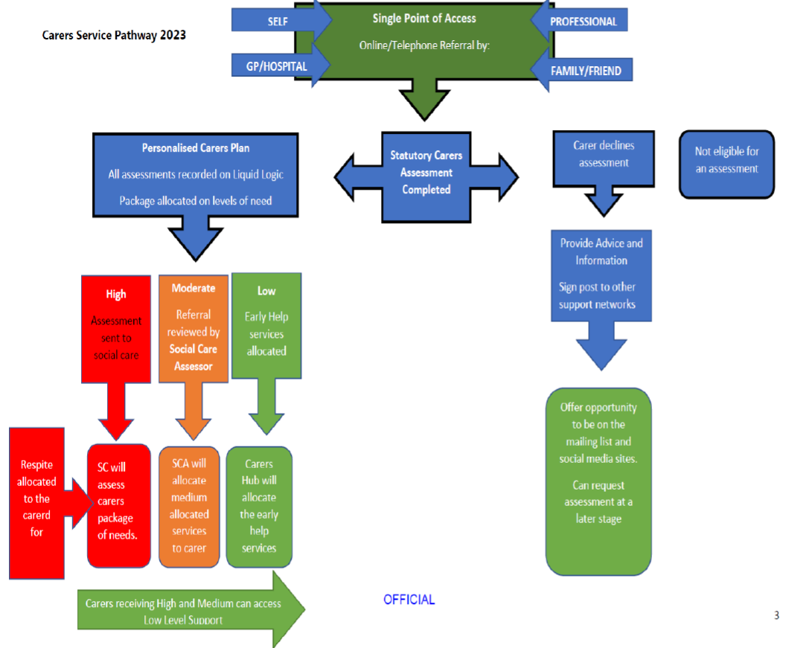

Slide 8
Cheshire East Carers Service Model
Annually:
To receive 2000 Adults and 400 Young carers referrals
For 1500 Adults and 250 Young to be new to the service
To maintain a total of 7000 Adult and 800 Young Carers registered with the service
To complete a Statutory Needs Assessment with 90% of new referrals
To complete an assessment for 95% of those that decline a SNA
90% of carers that have had an assessment offered/had an outcomes and support plan review

Slide 9
Cheshire East Carers Service Model
Annually:
15 Different Schools engaged with
90% of these will have engaged in young carer training
80% of these schools will have a young carers champion in place
16 In person Adult/parent carer sessions provided per month
16 In person Young carer sessions provided per month
4 Awareness raising events per month

Slide 10
Progress (from 01.01.23 - to date)
To achieve these targets we must first embed change:
- Recruited the appropriate team
Provided the required training for staff (ongoing)
Induction of TUPE staff included Social Care Institute of Excellence Strengths based training
Are implementing operational changes including:
More remote assessments and support
Flexible home office working
Standardised and clearly defined case parameters

Slide 11
Progress (from 01.01.23 - to date) cont….
- Implement the software that allows us to accurately review what is working/what is not working
Enable quality of support throughout these changes
Continuous review of existing practice and consulting on changes to meet requirements of the new model and KPI’s
Engaging continuous promotional campaign
Increased referrals (but also increased wait times)

Slide 12
Ongoing Support During Change
Directing Carer to useful websites/published information
Statutory Carers Assessment
Non Statutory Assessment
Emergency Planning
Emergency Card
Risk Assessments
Safeguarding Referral
Safeguarding follow up support/review
Interventions / Support
Social care system explained/discussed
Advice for navigating social care system to meet Carers/cared for needs
Informing around Carer rights (including Carer and cared for right to a needs assessment)
Practical support/guidance regarding:
home management
finance/budgeting
nutrition and shopping
Exploring existing community assets and how they can meet the needs/interest of the Carer.

Slide 13
Ongoing Support During Change cont…
Hospital Discharge Fund
Referral into other agencies/services
Signposting into other agencies/services
Referral Submitted Follow Up
Training for Carers
Groups and activities
Interventions / Support continued:
Strengths focused discussions
Wellbeing Session / Emotional support
Crisis support
Advocate for Carer with other agencies
Liaising with other agencies/services for the carer
Liaising with other agencies/services re the Cared For
Collaborative work with other professional (to achieve best outcome for the Carer)
Facilitating access/attendance to another service/support
Living Well Fund – linked to outcomes

Slide 14
Ongoing Support During Change cont…
GROUPS ADULTS
Craft Art and Multi Media
Walk and Talk
Afternoon Tea
Carers Sat Big Breakfast
Cheerbrook Farm
Macclesfield Art Space
Craft afternoon tea
Blaze Farm
Pot painting and tea
Wizard Walk
GROUPS YOUNG
Outdoor activities
Picnics
Dancing
Walk and talk sessions
Roller disco
Canoe Trips
Canal boat trips
Park meet up
Exotic animals visit
Sibling activities
Toolkit for Wellbeing
CARER TRAINING
Emergency First Aid
Manual Handling
Infection and prevention control and the safe handling of medication
Basic food safety, nutrition and fire safety on the home
The benefit of receiving a Statutory Carers Assessment, looking after your health and wellbeing
Scam awareness, safeguarding concern and mental capacity awareness

Slide 15
Development Plans
- Take a break solution
- Dementia offer standardised across all staff
- DISC training for carers
- Computerised CBT for Young Carers and Parent Carers
- Expand on training for Carers
- News Letter re-launch
Use of case management software to review the effectiveness of service model
Are we meeting in meeting carers needs/outcomes
Are we using staff time effectively
- Carer Confident accreditation
- Continued promotion of the service to reach carers not already known to us
- Co-production events embedded as standard practice - You said/We Did

Slide 16
Cheshire East Carers Service

